Slide 1
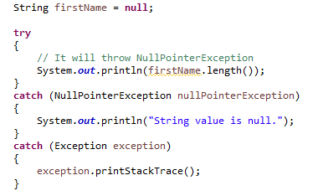

Java Unreachable Catch block
All catch blocks must be ordered from most specific
to most general i.e. catch for NullPointerException must
come before catch for Exception .

Slide 2
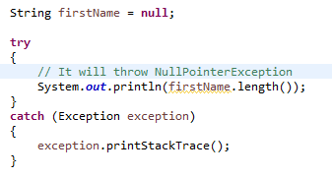
Java Unreachable Catch block
Exception is a Super class of NullPointerException,So this block can handle NullPointer Exception.

Slide 3
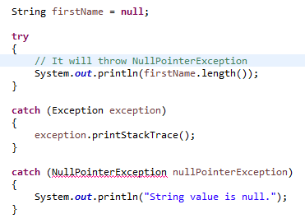

Java Unreachable Catch block
While using multiple catch statements, it is important to remember
that exception sub classes inside catch must come before any of their
super classes otherwise it will lead to compile time error.
This block handles all Exception.

